Slide 1
Spray application of in situ cross-linkable multi-layered hydrogels for medical applications 医療用in situ架橋マルチレイヤーハイドロゲルの スプレー投与システム
医科学専攻修士課程修士論文発表会
指導教員：伊藤大知 准教授
41-156214 Zheng Ying Grace
Notes:
Let me begin my presentation with the following title.

Slide 2
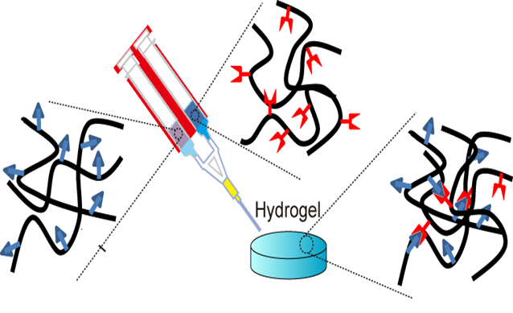
Introduction 1
In situ cross-linkable hydrogels
Gels formed by simple mixing of two different polymers
Merits:
Cover complex tissue geometries
Used in both open & laparoscopic surgeries
Used in various biomedical applications:
Scaffolds for tissue engineering
Clinical procedures
Hemostasis
Tissue adhesion prevention
Notes:
In situ cross-linkable hydrogels refer to gels formed by the simply mixing of two different polymers. With merits such as the ability to cover complex tissue geometries and can be used in laparoscopic procedures, they are used in a wide range of biomedical applications, including tissue engineering, and clinically as well.

Slide 3
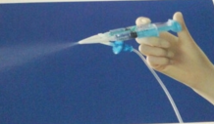
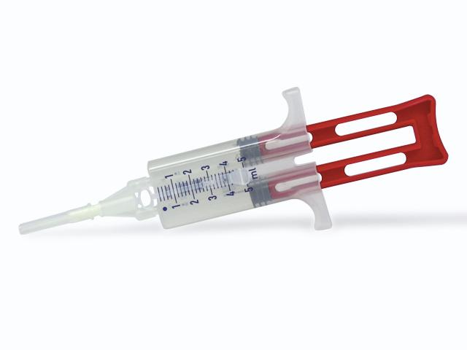
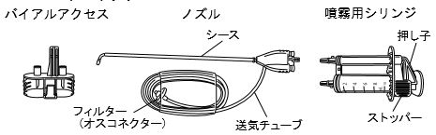
Introduction 2
Biomedical spray devices for clinical uses
One method of delivery of in situ cross-linkable hydrogels
Advantages:
Even delivery onto varying tissue surfaces
Less tissue handling
Fibrin sealants
Tissue adhesion barriers
Tisseel®
Adspray®
Bolheal®
>50% of hemostats market share
Few
Sprays for adhesion prevention remains largely unstudied
Notes:
One method for delivery of in situ cross-linkable hydrogels is through the use of sprays. Sprays can not only deliver materials evenly onto tissue surfaces, it also reduce the risk of additional tissue trauma with less tissue handling.
Various spray devices are available for use clinically. In particular, a wide range of sprayable fibrin sealants are available for hemostasis. On the other hand, the number of approved sprayable tissue adhesion barriers remain few, with Terumo’s Adspray being approved for domestic use very recently. As such, it can be said that spray devices for adhesion prevention remains largely unstudied.

Slide 4
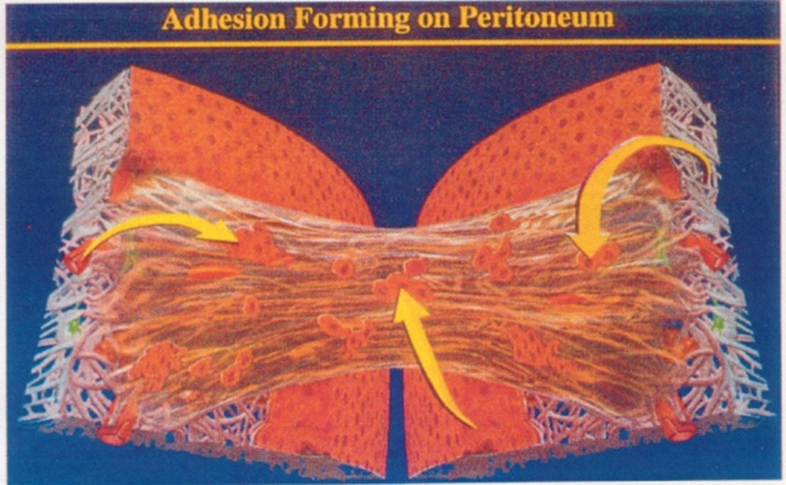
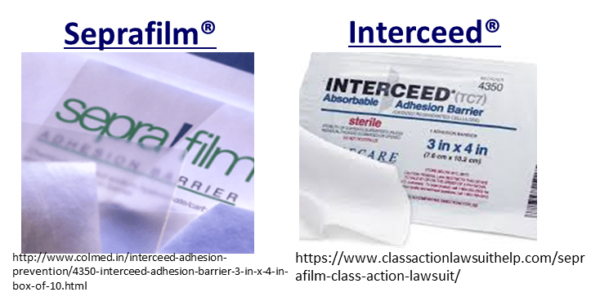
Introduction 3
Tissue adhesion
Abnormal fibrous bands attaching 2 adjacent body tissues
Occurs after 54% of abdominal surgeries
Problems such as pelvic pain etc.
G.S.Dizerega and J.D. Campeau: Human Reproduction Update 2001(7)547-555
Tissue adhesion barriers
Physical separation of tissues
Commercially available adhesion barriers have limitations:
X Brittle
X Low efficacy in surgeries with heavy bleeding
Limited efficacy of a single material
Need for improved material → Combination of various materials
Notes:
To elaborate further on tissue adhesion. Tissue adhesion refers to the formation of abnormal fibrous bands that attach two adjacent tissues in the body. It occurs very frequently, causing problems such as pelvic pain.
To prevent tissue adhesion formation, adhesion barriers are used. However, currently available adhesion barriers have limitations. Sheet-type Seprafilm and Interceed are brittle, and thus not effective for use in surgeries that induce heavy bleeding. This highlights the limited efficacy of a single material, and the need for an improved material that is suitable for use in various surgical procedures. One possible way to address this would be to combine various materials.

Slide 5
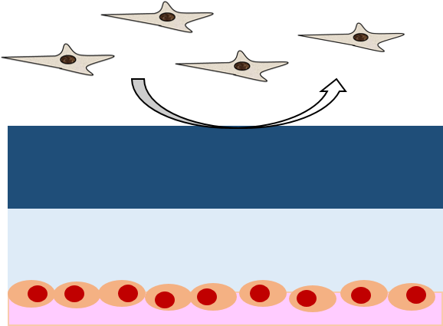
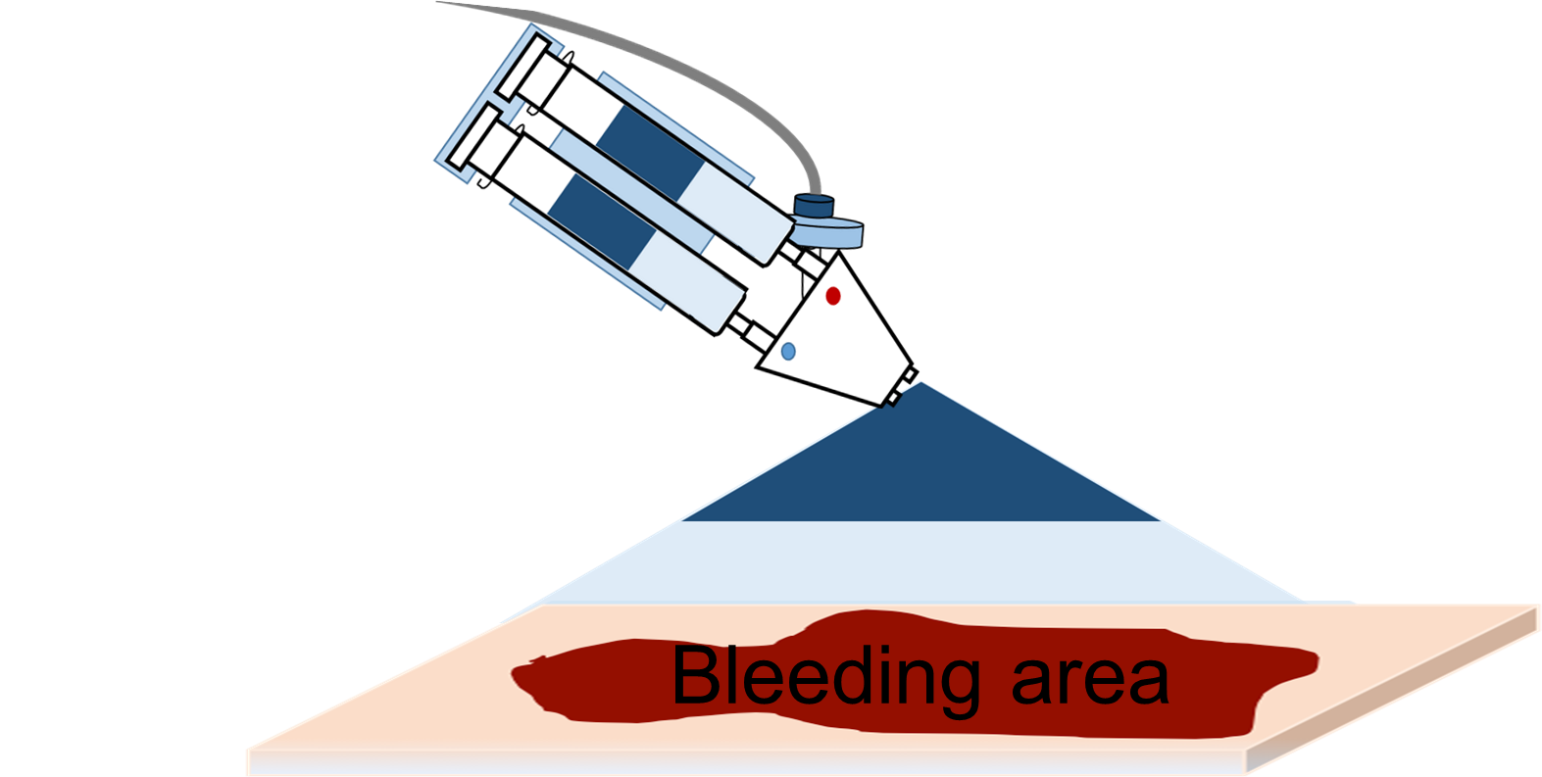
Objective
Objective
Spray application of multi-layered in situ cross-linkable hydrogels for tissue adhesion prevention
N2 gas
Liquid B
Top
Non-adhesive
Promote wound healing
Bottom
Liquid A
Multi-layer → Multi-functional
Wound surface
Notes:
As such, in this study, fabrication of a multi-layered in situ cross-linkable hydrogel by spraying for the prevention of tissue adhesion. The idea here is that each individual layer will have different properties. Here, the bottom layer to be in contact with the wound surface will serve to promote wound healing. On the other hand, the top layer away from the wound surface will serve as a physical barrier between wound surface and the surrounding tissue surface.

Slide 6
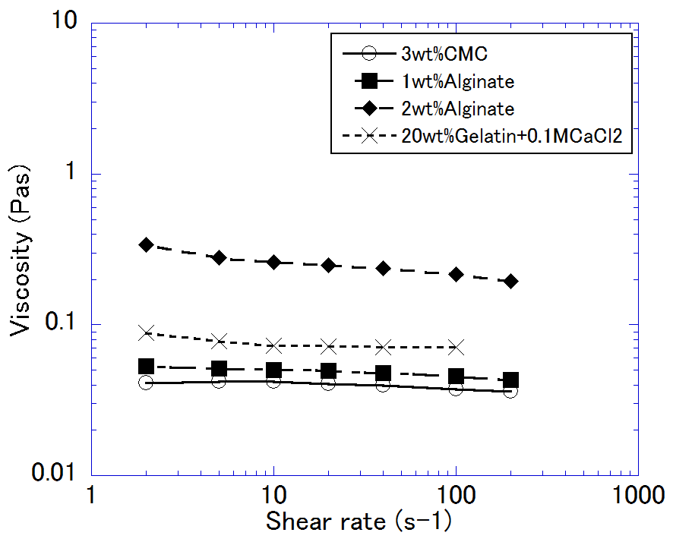
Materials
Materials
Viscosity of materials:
 | Liquid A | Liquid B
Top (away from wound surface) | 1wt% Alginate | 3wt% Carbomethyl cellulose (CMC)+ 0.1MCaCl2
Bottom (in contact with wound surface) | 2wt% Alginate+ 1wt% Transglutaminase (TG)* | 20wt% Gelatin+0.1MCaCl2
Alg-CMC
Alg-gelatin
* [TG] was evaluated by fellow lab member Kikuchi E. 東京大学工学部卒論 (2016)
Notes:
The top layer (away from wound surface) will compose of Alginate and carboxymethyl cellulose (CMC). CMC is known for its anti-adhesive nature, and has been used in various commercially available tissue adhesion barriers including Seprafilm.
On the other hand, the bottom layer will compose of Alginate and transglutaminase-crosslinked Gelatin aimed to promote cell adhesion and migration.
For convenience, in the rest of the presentation, the top layer will be simply called Alg-CMC, and the bottom layer as Alg-gelatin.

Slide 7
Experiment 0
Experimental flow
Spray characterization
Spray coverage
In vitro analysis
Cell viability
In vivo analysis
Rat hepectatomy adhesion model
Cell migration
Gel thickness
Droplet size
Optimization of
spray conditions
Effect of spray conditions and materials on cells
Response to
multi-layered hydrogels
Notes:
A general outline of the experiments:
First spray characterization was done to optimize conditions necessary for forming multi-layered hydrogels.
Next, in vitro experiments was conducted to evaluate the effect of varying spray conditions and materials on cells.
Lastly, fabrication of multi-layered hydrogels was attempted, and its efficacy was tested in vivo using the rat liver resection model.

Slide 8
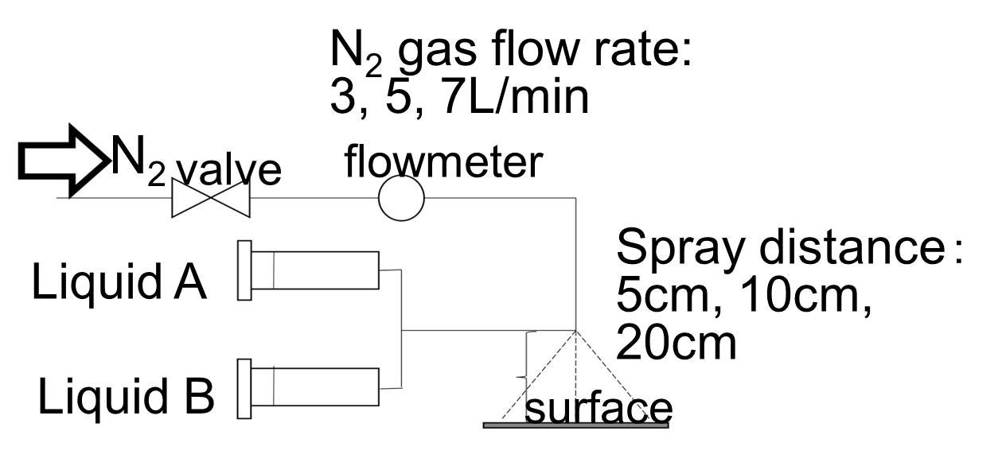
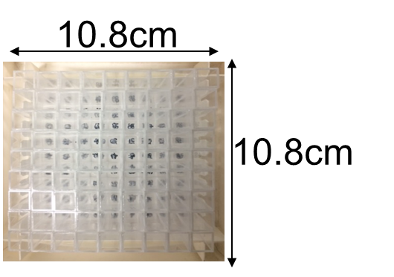
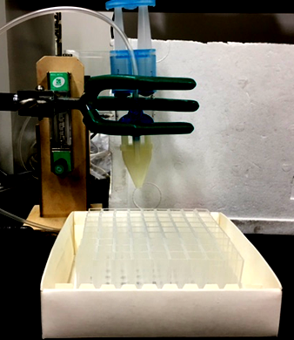
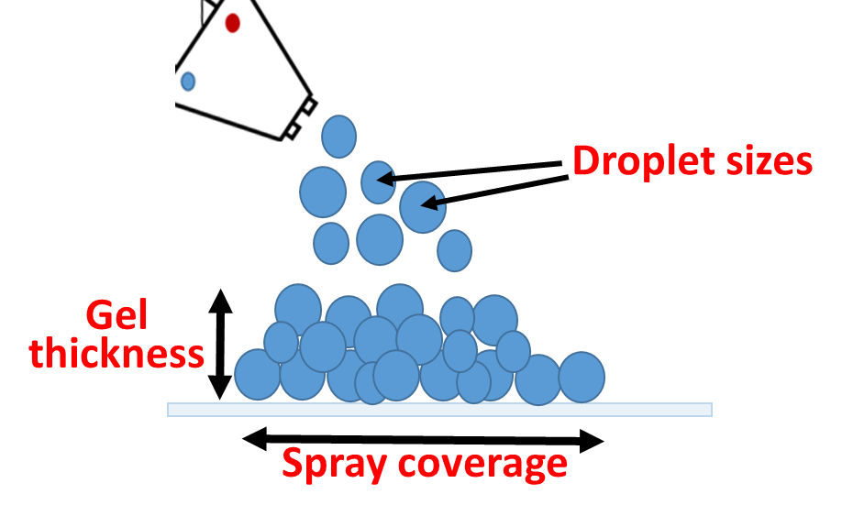
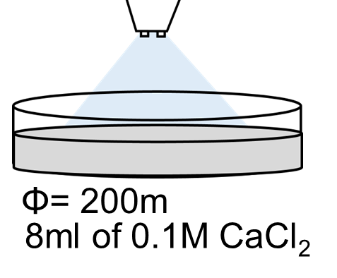
Experiment 1
Spray characterization
N2 gas flow rate:
3, 5, 7L/min
Spray coverage
Gel thickness
Actual set-up:
Spray distance:
5, 10, 20cm
Homogeneity
Droplet sizes
While stirring
Mixing efficiency
Notes:
For spray characterization, by keeping liquid flow rate constant manually, gas flow rate and spray distance were varied, and spray parameters including spray coverage, gel thickness, as well as droplet sizes were measured.

Slide 9
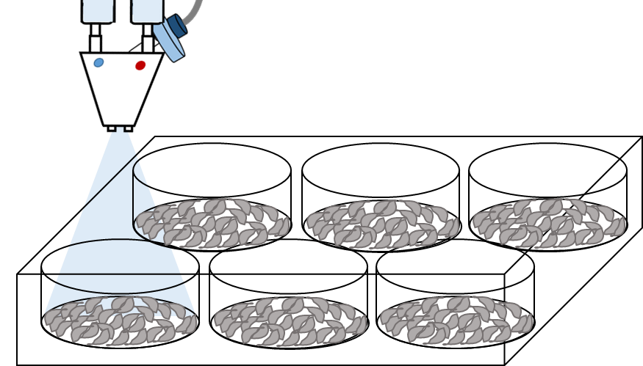
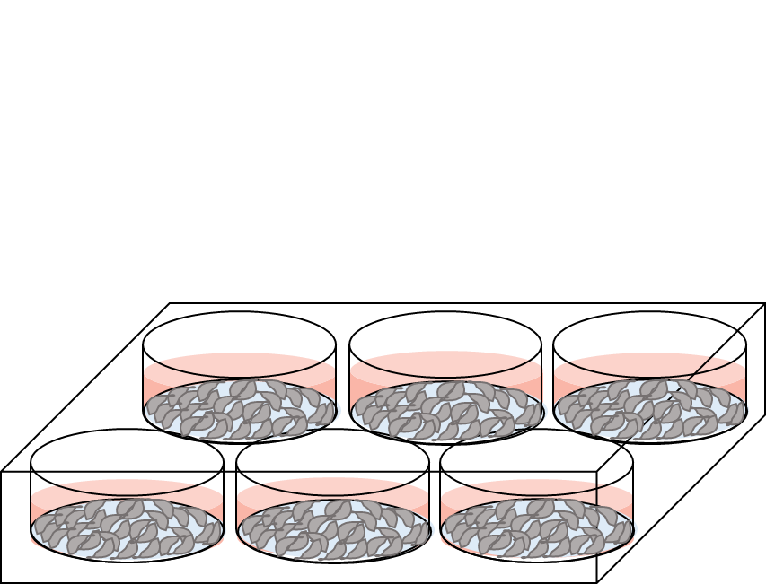
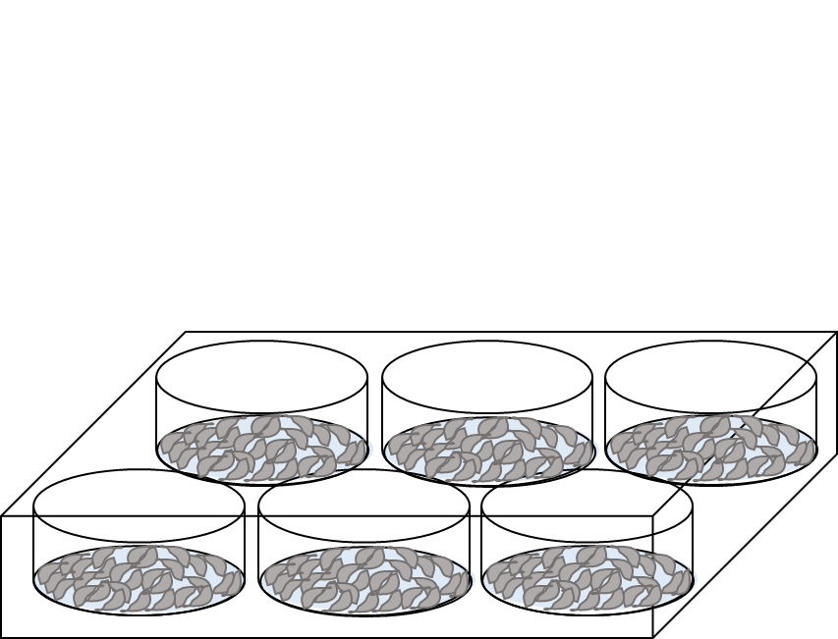
Experiment 2
In vitro evaluation of cell damage by spraying
Cell types: NIH-3T3 fibroblasts, MeT-5A mesothelial cells
Gas flow rate: 3, 5, 7L/min
Spray distance: 5, 10, 20cm
Materials sprayed
Medium added
24h
WST cell viability assay
24h
Live/Dead staining
Gel and medium aspirated
Notes:
Next, materials were sprayed onto cells at varying spray conditions, and its effect on cell viability were analyzed quantitatively using WST assay, and qualitatively using Live/ Dead staining.

Slide 10
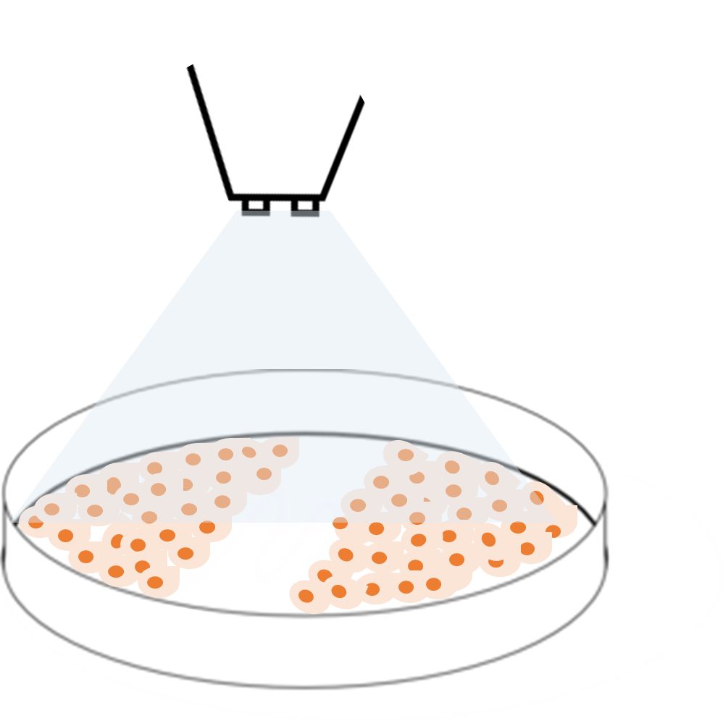
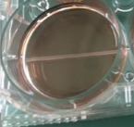
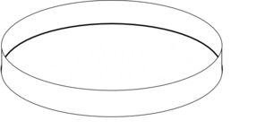
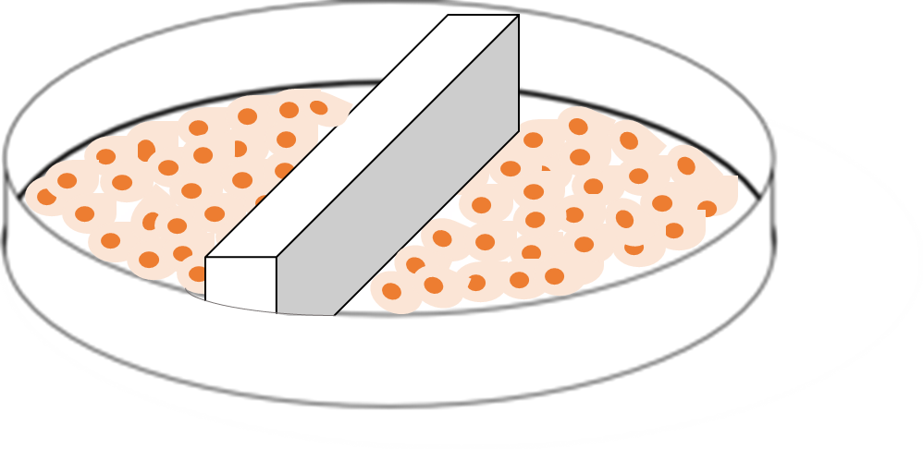
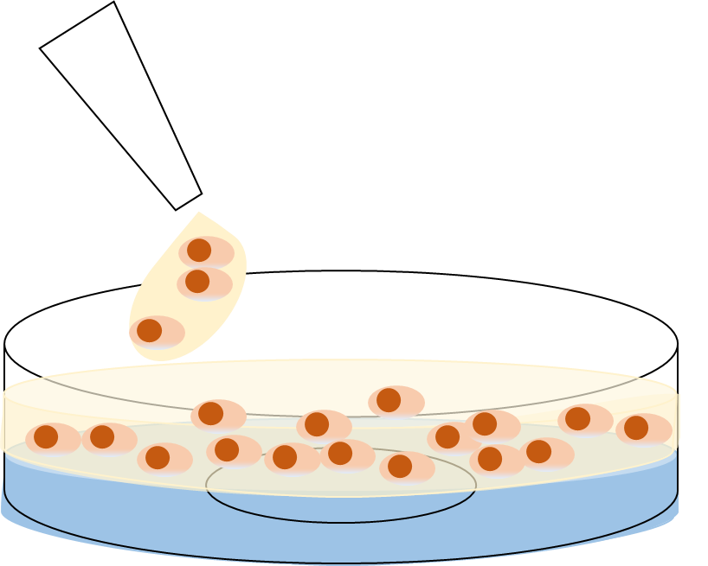
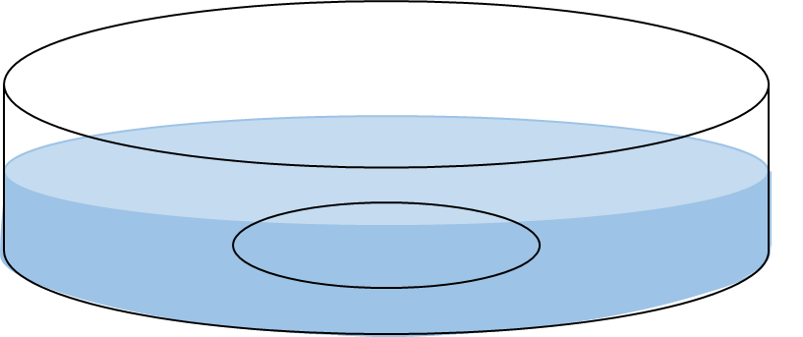
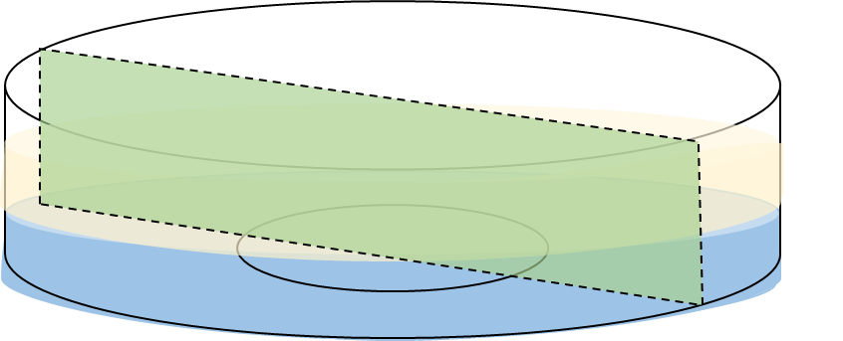
Experiment 3
In vitro evaluation of cell migration
To functionally differentiate the two layers
‘Scratch’ wound healing assay
Width≈1mm
Silicon mold inserted
before cell seeding
Mold removed
Materials sprayed
Wound closure
observations
Cell penetration assay
Height≈1mm
Gels added via double syringes
Fluorescently labeled cells seeded onto gel
Observations of transverse gel sections
Notes:
Next, the effect of varying materials on cell migration was studied
In the scratch assay, a scratch was created across cell monolayers to mimic traumatized wound surfaces. The closure of the scratch wound by horizontal cell migration was then studied.
In the cell penetration assay, fluorescently labeled cells were seeded onto gels, and vertical migration of cells through the gels were then evaluated using confocal microscopic observations of the transverse gel sections.

Slide 11
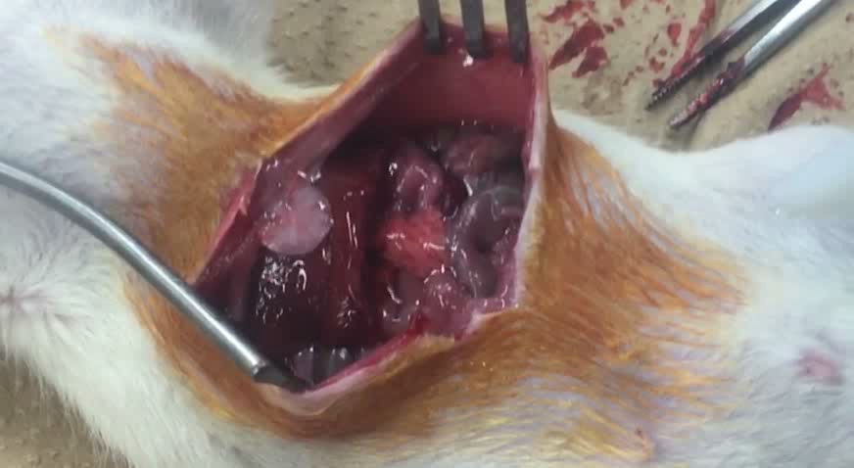
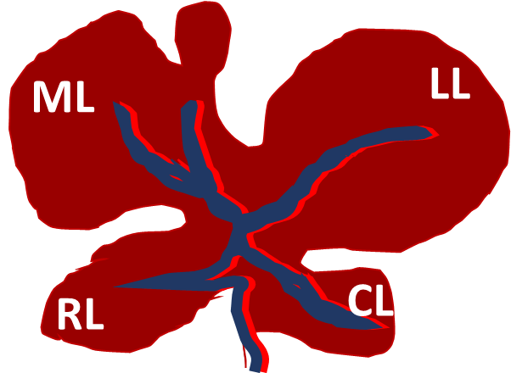
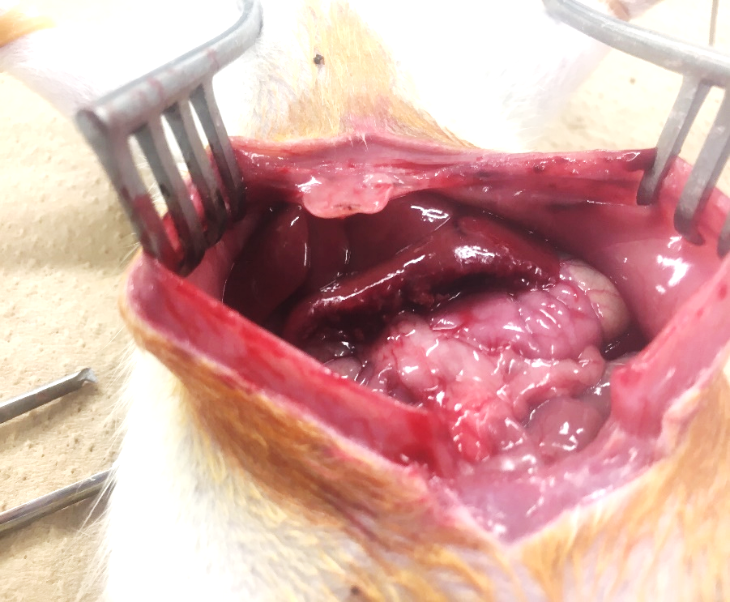
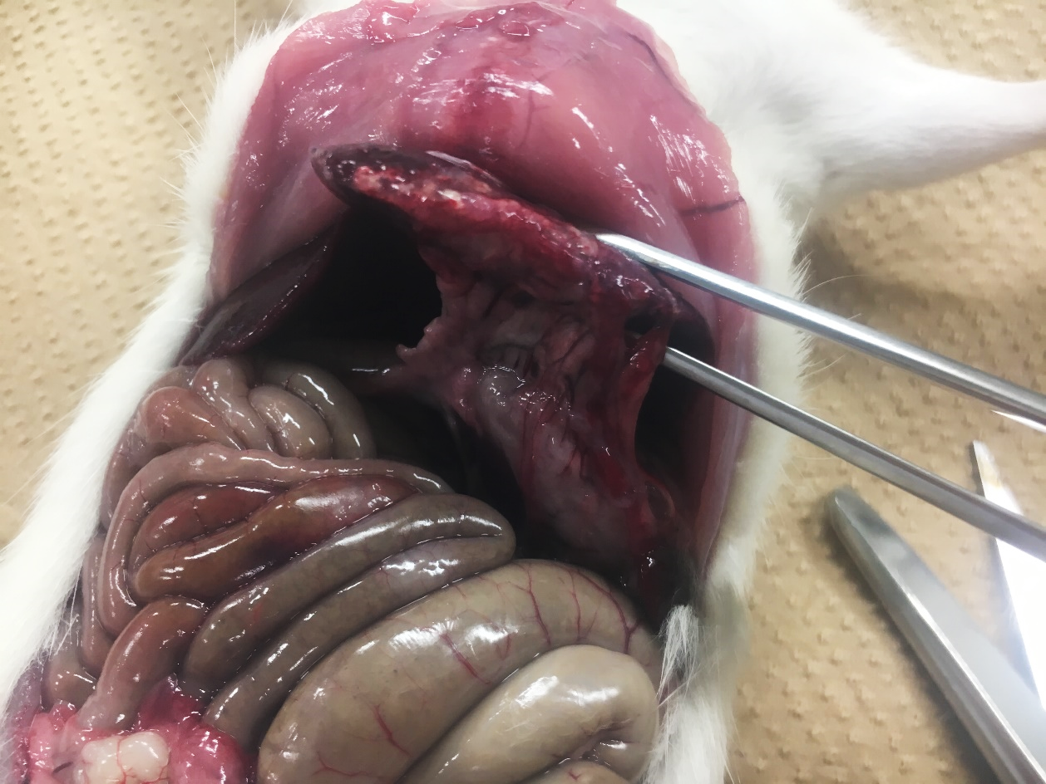
Experiment 4
In vivo evaluation
Rat hepatectomy model
Control
Alg-CMC
Alg-gelatin
Double layer
8-11 week old SD rat ♂
3cm of left lateral lobe of liver was transected
5L/min at 5cm
0.2ml x2
Evaluation after 1 week
EXTENT
GRADE
Grade 0: No adhesion
Grade 1: Spontaneously separating adhesion
Grade 2: Adhesions separated by blunt dissection
Grade 3: Adhesions separated by sharp dissection
Notes:
The efficacy of the multi-layered hydrogel fabricated by spraying was then tested in vivo using the rat hepatectomy model.
In this model, 8 week male SD rats were used. 3cm of the LL lobe of the liver was electrocauterized.
To the cut liver surface, various materials were sprayed at an intermediate gas flow rate of 5L/min at 5cm.
After one week, the rats were sacrificed and the extent and grade of the adhesions formed were evaluated.

Slide 12
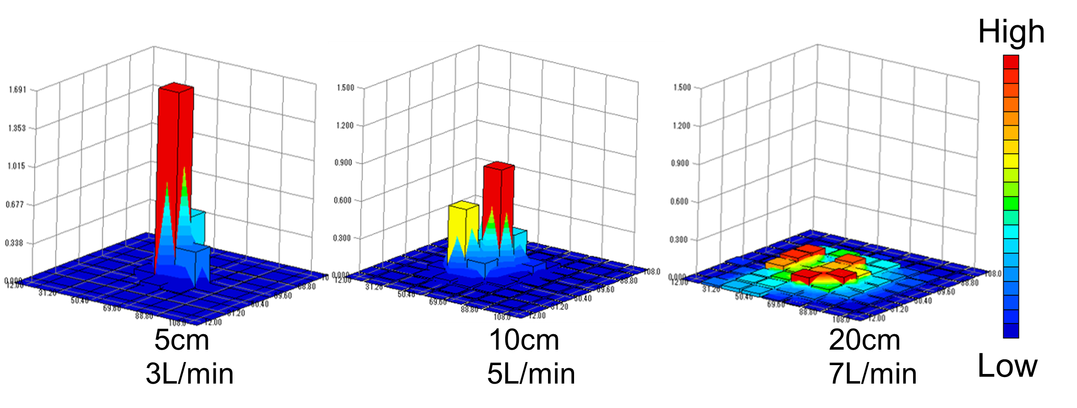
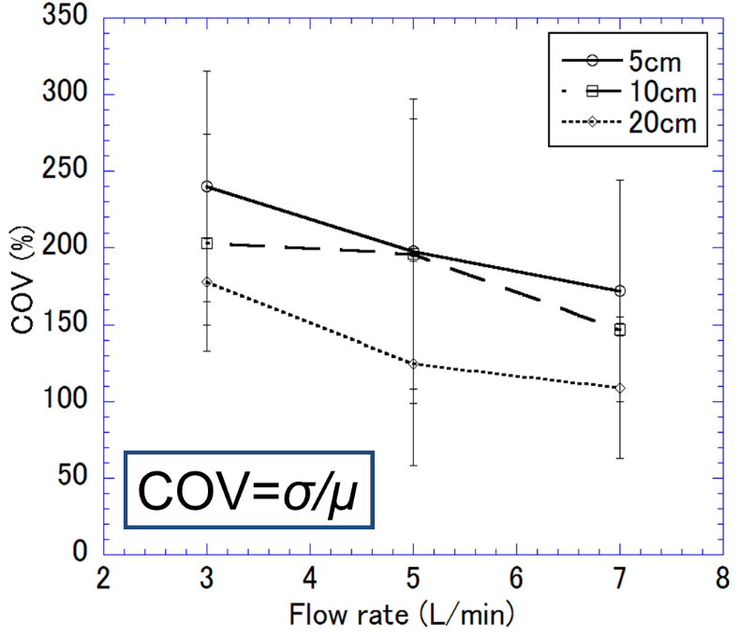
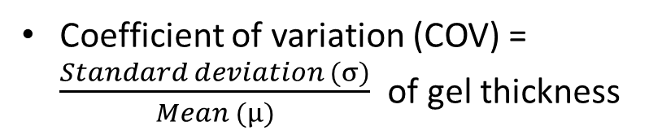
Result 1
Evaluation of homogeneity
High
Thickness
Spray coverage
Spray coverage
Spray coverage
Spray distance
Gas flow rate
5cm 10cm 20cm
Low
3L/min 5L/min 7L/min
Recovery rate
96.4% 83.3% 78.7%
Evaluation of homogeneity
Coefficient of variation (COV) = $\frac{Standard deviation (σ)}{Mean (µ)}$ of gel thickness
The higher the gas flow rate and spray distance,
the higher the homogeneity
Notes:
Results of the spray characterization are as follow:
These are some examples of the spray distribution graphs obtained. As gas flow rate and spray distance increased, spray coverage increased while gel thickness decreased. These values were determined and used to evaluate homogeneity of the gels formed. It was found that the higher the gas flow rate and spray distance, the more homogenous the gel was.

Slide 13
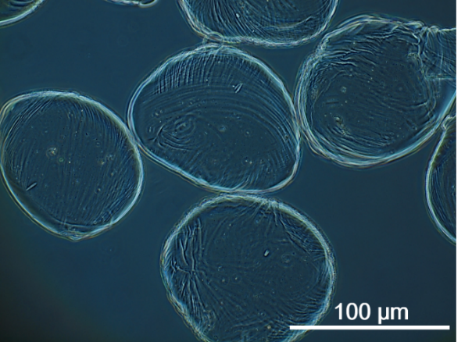
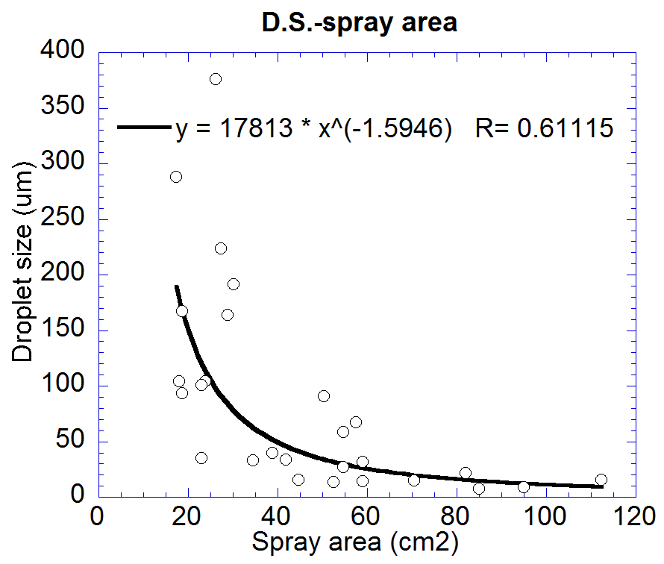
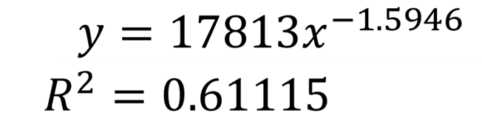
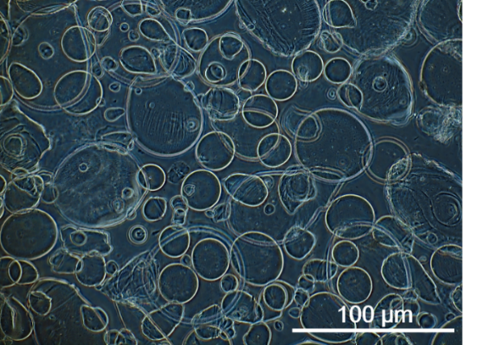
Result 2
Droplet size measurements
Spray distance: 5cm
Gas flow rate: 3L/min
Material: 0.5, 1, 2, 3wt% Alginate
Spray distance: 10cm
Gas flow rate: 7L/min
Smaller droplets with larger spray coverage
High gas flow rates
High spray distances
High homogeneity
High mixing efficiency of gels
Notes:
Next, droplet sizes were measured. These are some examples of the droplets collected.
Droplet sizes were plotted against spray coverage, and it was shown that smaller droplets correlate with larger spray coverage. This relationship can be quantitatively expressed by this equation.
Putting together the spray characterization results, high gas flow rates and spray distances resulted in high homogeneity and mixing efficiency of gels formed.

Slide 14
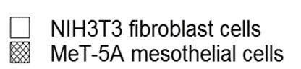
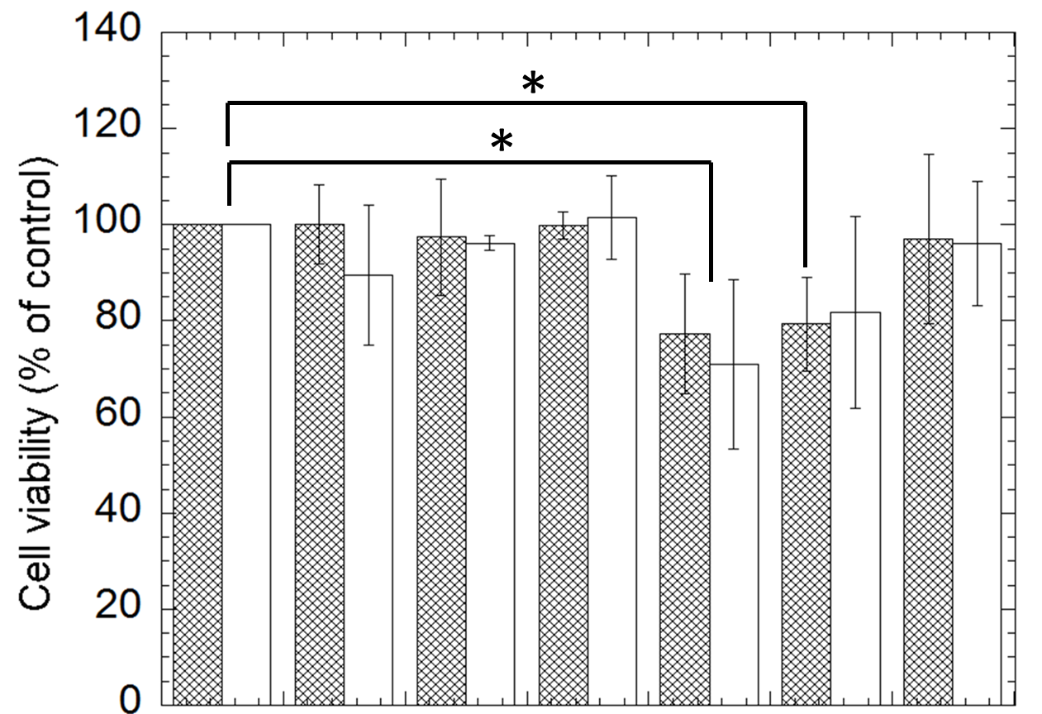
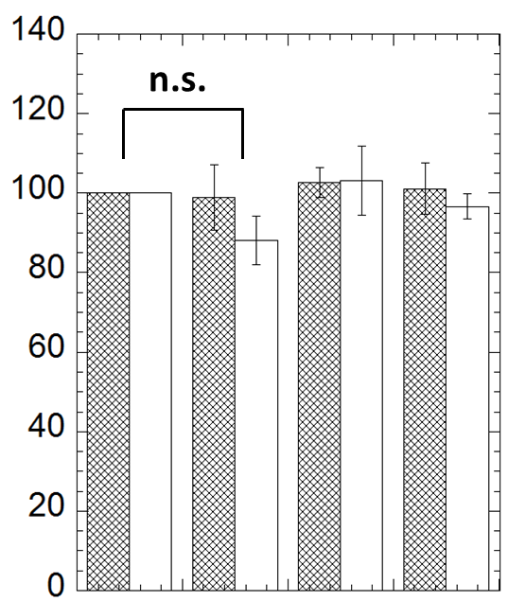
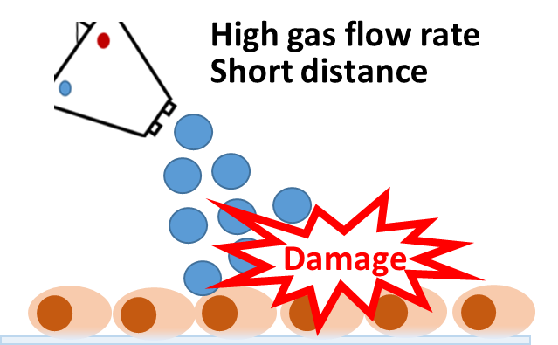
Result 3
In vitro analysis: WST assay
Alg-CMC at varying spray parameters
Air only
* p<0.05
Control 5cm 10cm 20cm
7L/min
Control 5cm 10cm 20cm 5cm 10cm 20cm
3L/min 7L/min
Materials sprayed at high gas flow rate and short distances caused significant cell death
Notes:
Results of the WST assay showed that materials sprayed at high gas flow rate of 7L/min and short distances of 5cm and 10cm caused a significant decrease in cell viability. However, this trend was not observed when no materials were delivered.
To further understand the reason for the reduced cell viability, Live/Dead staining was conducted.

Slide 15
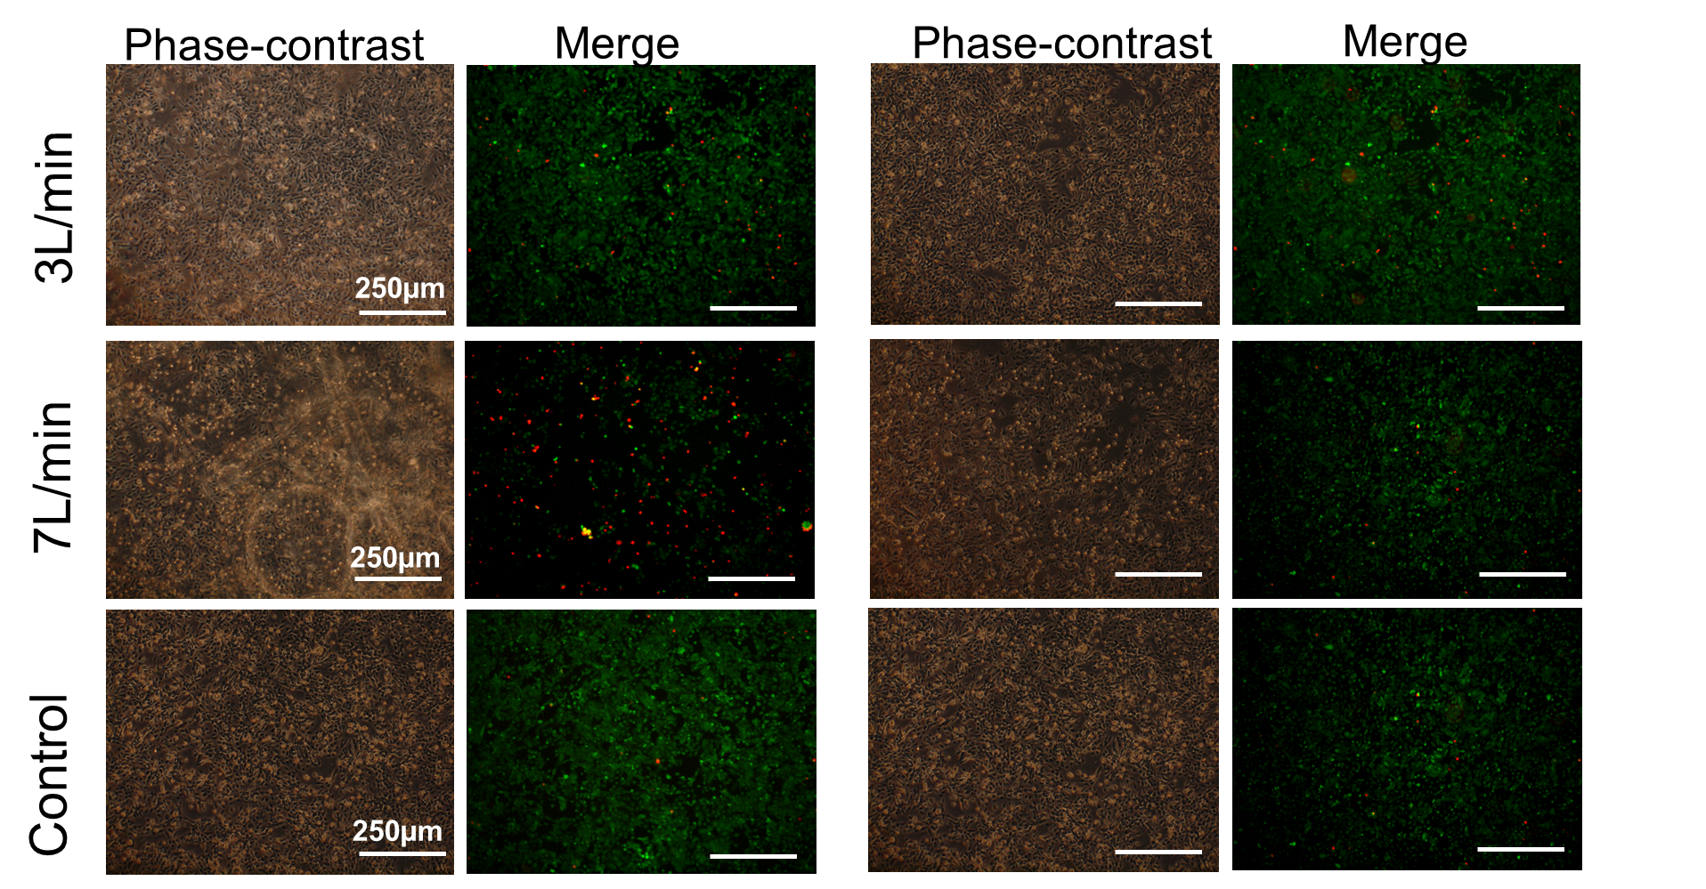
Result 4
In vitro analysis: Live/Dead Staining
Spray distance =5cm
Spray distance =20cm
Green= Live cells Red= Dead cells
Materials sprayed at high gas flow rate and short distances caused cell detachment and cell death of remaining attached cells
Notes:
The Live/dead staining results showed that materials sprayed at high gas flow rate and short distance caused detachment of cells, as seen from the lower cell fluorescence intensity), and also induced cell death in the remaining attached cells, as shown by the high ratio of red cells.

Slide 16
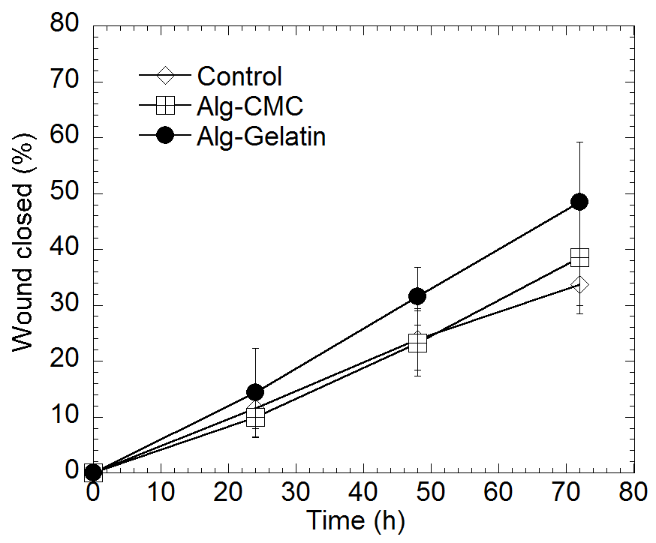
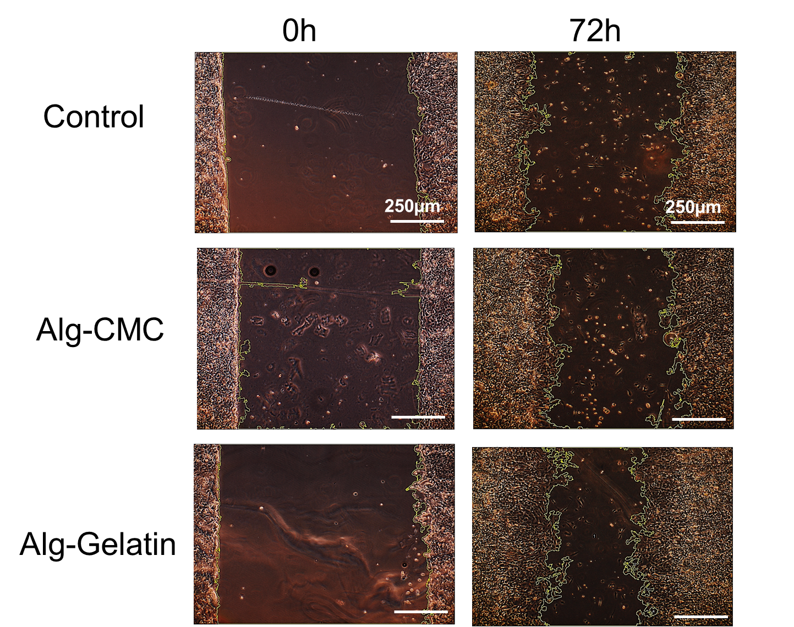
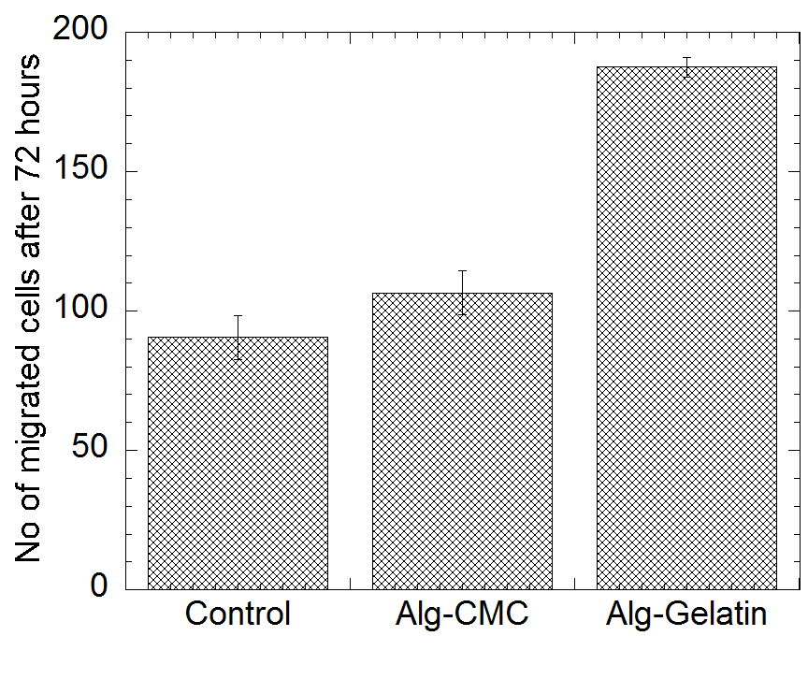
Result 5
In vitro analysis: ‘scratch’ assay
Observations of ‘scratch’ wound closure
0h
72h
Control
Alg-CMC
Alg-gelatin
Alg-gelatin promoted horizontal cell migration
Notes:
For the scratch assay, a faster rate of scratch wound closure was observed when Alg-gelatin was added. Quantitative evaluation of migrating cells also showed a larger number of migrating cells when Alg-gelatin was added.

Slide 17
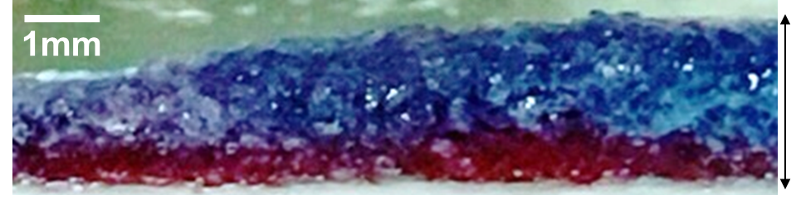
Result 6
Fabrication of multi-layered hydrogels
Different colored food dyes added to materials before spraying
Transverse section of gel:
Top layer: Alg-CMC
3mm
thickness
(Spray distance: 10cm
Gas flow rate: 5L/min)
Bottom layer: Alg-gelatin
Multi-layered hydrogel was successfully fabricated
Notes:
With this, feasibility of multi-layered hydrogel fabrication was tested.
Two distinct layers of Alg-CMC and Alg-gelatin were observed.

Slide 18
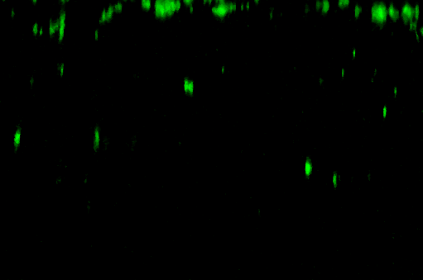
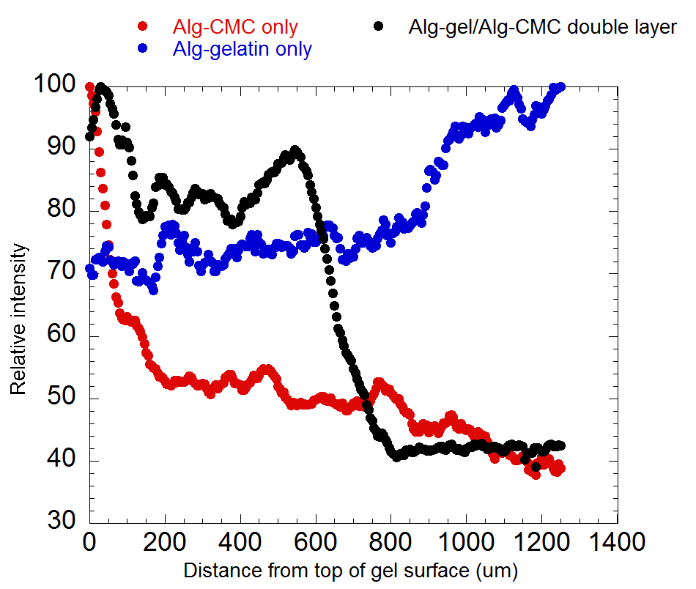
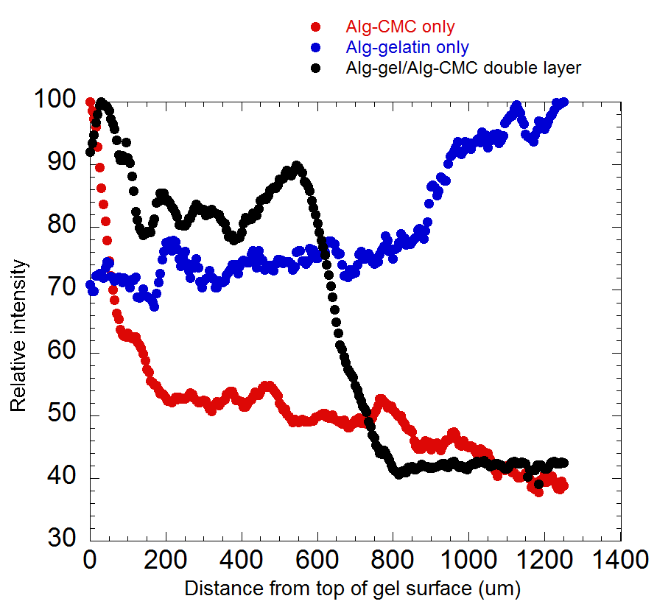
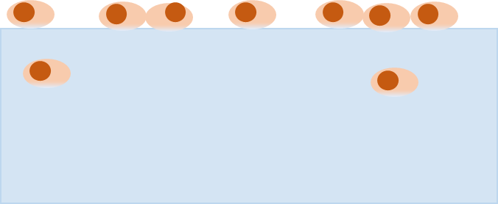
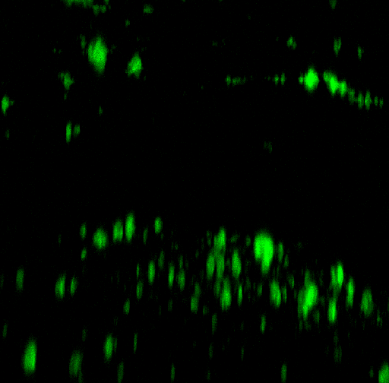
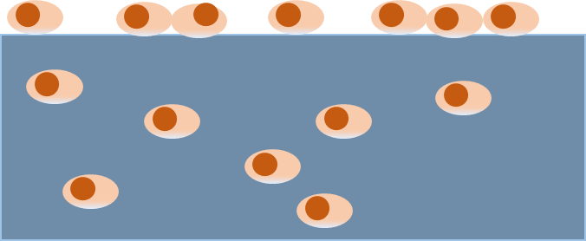


Result 7
In vitro analysis: cell penetration assay
Transverse gel sections after 24h
Fluorescence intensity
Migration
direction
Top
Alg-CMC layer
Bottom
Migration
direction
Top
Alg-gelatin layer
Bottom
Top
Migration
direction
Alg-gelatin
Cells migrated quickly through Alg-gelatin, not Alg-CMC
Alg-CMC
Double layer
Bottom
Notes:
Results of the cell penetration assay also showed higher cell intensity in the Alg-gelatin gels, suggesting that cells migrated through the Alg-gelatin much faster than the Alg-CMC gel.

Slide 19


Result 8
In vivo analysis
Cut liver surface-greater omentum (離断面と大網)
Adhesion grade
Adhesion extent
* p<0.05 ** p<0.01
Alg-gelatin single layer worsened adhesion extent
Double layer improved adhesion extent
No significant difference between control and double layer
Notes:
Results of the in vivo experiments showed that spray application of materials improved adhesion grade slightly.
However, looking at the extent of adhesions, the alg-gelatin single layer caused a significant increase in adhesion extent as compared to when Alg-CMC single layer, or when double layer was applied.
No significant difference was observed between control and when double layer was applied.

Slide 20


Discussion
Discussion
At LOW gas flow rate:
Reduced adhesion formation
Alg-CMC
?
Alg-gelatin
Vertical
At HIGH gas flow rate:
?
Droplet size ↓
Spray coverage ↑
Horizontal
Promoted wound healing
X Worsened adhesion formation
Mixing efficiency
Homogeneity
Trade-off
Cellular damage
Precise control of thickness of each layer is needed
Notes:
Putting together the results,
Results from the spray characterization showed that when gas flow rate and spray distances increased, spray angle increased while droplet sizes decreased, thus desirable for high mixing efficiency and homogeneity. However, in vitro evaluation of spray conditions showed that high gas flow rate and distances caused significant cell damage, suggesting a trade off relationship between mixing efficiency, homogeneity and cell viability.
In vitro evaluation of materials showed that the Alg-gelatin layer promoted both horizontal and vertical cell migration, proving its high potential in wound healing. The anti-adhesive nature of the Alg-CMC layer was also shown in the in vivo experiments. However, in vivo results also showed that alg-gelatin single layer worsened adhesion extent. In the current set of experiments, the volume of materials added were in the ratio of 1:1. As such, to optimize the efficacy, future works would require precise control and optimization of the thickness of the individual layers.

Slide 21
Conclusion
Conclusions
Spray distribution and droplet sizes were measured
Impact of spray conditions on cell viability was evaluated
The wound healing property, and the anti-adhesive property of the respective hydrogel layers were shown
Multi-layered hydrogel was successfully fabricated
Efficacy of the multi-layered hydrogel delivered by spraying was evaluated using the rat hepatectomy model
Notes:
In conclusion….

Slide 22
Acknowledgements
Acknowledgements
Special thanks to Kaketsuken/Sumitomo Bakelite for the provision of double syringes, Kimica for the provision of alginate, Nitta Gelatin for the provision of gelatin, and Ajinomoto for the provision of transglutaminase.
Prof. Kokudo, Associate Prof. Hasegawa, Dr. Inagaki, Dr. Toda from the HepatoBiliary-Pancreatic Surgery Division, Department of Surgery, Graduate school of Medicine at the University of Tokyo.
Associate Prof. Ito for all the guidance, Assistant Prof. Ohta for help with the animal experiments, and fellow lab members for their advice and support in one way or another. ☺
Notes:
I would like to express my deepest gratitude to the following people, and with this, I have come to the end of my presentation.
would like to thank the following companies and with this, I have come to end of my presentation.

Slide 23
Supplementary

Slide 24

Addition of materials into syringes
1wt%alginate
3wt%CMC+0.1MCaCl2
2wt%alginate+1wt%TG
20wt%gelatin+0.1MCaCl2

Slide 25


Multi-layered materials for adhesion prevention
mPEG-PLGA ﬁlm
Park S. et al., fabricated bilayer membrane to prevent adhesion and promote wound healing at the same time
porous Col-HA layer
Xia and Liu et al. fabricated trilayered barrier membrane for hemostasis and tissue adhesion prevention
PLGA/PLA-b-PEG electrospun layer between layers of carboxymethyl chitosan (CMCS) sponge
Mainly sheet type → In situ cross-linkable hydrogels not yet explored
Park S. et al., J Mater Sci: Mater Med (2007) 18:475–482
Xia Q., Liu Z., Wang C. et al. (2015) Biomacromolecules, 16(9):3083-3092
Notes:
Various materials, such as HA and Alginate, have been used as materials for in situ cross-linkable adhesion barriers.
However, the question as to whether a single is effective to prevent tissue adhesion
Peope have been looking at the development of multi-layer materials. For example, Park et al fabricated bilayer….
However….

Slide 26


Materials
Materials
Alginate
Natural polysaccharide from algae
Cross-links with Ca2+
CMC
Excellent anti-adhesive properties
Used in tissue adhesion barriers (e.g. Seprafilm®)
Gelatin
Cross-links with TG to promote cell adhesion and migration[1]
Transglutaminase
Class of natural enzymes that catalyze the acyl-transfer reaction between a free amine group in lysine and a free acyl group in glutamine
Found in tissues, blood, and even on cell surfaces
Cell binding amino acid sequences of Arg-Gly-Asp RGD present in gelatin. These sequences are identified by cellular integrin proteins, which in turn support various cell-response features including cell migration.
Notes:
With regards to the materials used:
The top layer (away from wound surface) will compose of Alginate and carboxymethyl cellulose (CMC). CMC is known for its anti-adhesive nature, and has been used in various commercially available tissue adhesion barriers including Seprafilm.
On the other hand, the bottom layer will compose of Alginate and Gelatin. Gelatin will cross-link with TG enzyme to promote cell adhesion and migration.

Slide 27




Spray coverage and thickness
Alg-CMC
Alg-gelatin
Spray coverage: 10 to 150${cm}^{2}$
Average thickness: 1 to 5mm
Spray coverage: 30 to 120${cm}^{2}$
Average thickness: 1 to 5mm
Notes:
Results of the spray characterization are as follow:
Shown here are just some examples of the spray distribution graphs. As seen, as gas flow rate and spray distance increased, spray coverage increased while gel thickness decreased. Spray coverage values were determined to be between 10 to 150cm2, while thickness was between 1 to 5mm. However, lower recovery rate was also observed with increased gas flow rate and spray distance.

Slide 28

COV of homogeneity
Alg-gelatin
Alg-CMC
Similar trend
Homogeneity appears to be lower for Alg-gelatin

Slide 29

Cell detection kit
http://www.dojindo.com/store/p/456-Cell-Counting-Kit-8.html
WST-8, is reduced by dehydrogenase activities in cells to give a yellow-color formazan dye
Amount of formazan dye, generated by the activities of dehydrogenases in cells, is proportionate to the number of living cells.

Slide 30
Cell detection kit
Live/Dead Staining
Calcein AM
Ethidium homodimer-1
→Calcein is well retained within live cells
→EthD-1 enters cells with damaged membranes and is excluded by the intact plasma membrane of live cells.

Slide 31

Cause of cell death
High gas flow rate at short distances caused cellular damage
Quantification of spray impact was attempted:
$$\frac{dv}{dt}=\left(ρ_{water}−ρ_{air}\right)g−\frac{18μv}{d^{2}}$$
Velocity reached equilibrium very quickly → velocity is the same for droplets at all spray distances
This assumes that air from the nozzle stops flowing once droplets are being delivered → However in reality, gas continues to flow through the nozzles throughout
Notes:
Results of the cell penetration assay also showed higher cell intensity in the Alg-gelatin gels, suggesting that cells migrated through the Alg-gelatin much faster than the Alg-CMC gel.

Slide 32

Cause of cell death
High gas flow rate at short distances caused cellular damage
Droplet size as a factor in causing cellular damage
Approximately the same size
Notes:
Results of the cell penetration assay also showed higher cell intensity in the Alg-gelatin gels, suggesting that cells migrated through the Alg-gelatin much faster than the Alg-CMC gel.

Slide 33

Cause of cell death
Cell viability – droplet sizes
Smaller droplet sizes corresponds to lower cell viability → impact of spray affects cell viability
Notes:
Results of the cell penetration assay also showed higher cell intensity in the Alg-gelatin gels, suggesting that cells migrated through the Alg-gelatin much faster than the Alg-CMC gel.

Slide 34

Types of cell death
Apoptotic/Necrotic Cells Detection Kit
FITC-Annexin V: binds to Phosphatidylserine (PS) on outer membrane of apoptotic cells
Ethidium Homodimer III:
nucleic acid probe and impermeant to live or apoptotic cells
Unplanned cell death
Programmed cell death
http://www.aleralabs.com/Latest/cell-death-assays-for-drug-discovery-part-1.html
Notes:
Results of the cell penetration assay also showed higher cell intensity in the Alg-gelatin gels, suggesting that cells migrated through the Alg-gelatin much faster than the Alg-CMC gel.

Slide 35


In vivo analysis
Grade 0: No adhesion
Grade 1: Spontaneously separating adhesion
Grade 2: Adhesions separated by blunt dissection
Grade 3: Adhesions separated by sharp dissection
Adhesion grade between
離断面と大網
No significant difference observed between any condition
Notes:
Results of the cell penetration assay also showed higher cell intensity in the Alg-gelatin gels, suggesting that cells migrated through the Alg-gelatin much faster than the Alg-CMC gel.

Slide 36

In vivo analysis
Adhesion extent at 非離断面
No adhesion observed when Alg-CMC layer was applied
Notes:
Results of the cell penetration assay also showed higher cell intensity in the Alg-gelatin gels, suggesting that cells migrated through the Alg-gelatin much faster than the Alg-CMC gel.

Slide 37


In vivo analysis
Grade 0: No adhesion
Grade 1: Spontaneously separating adhesion
Grade 2: Adhesions separated by blunt dissection
Grade 3: Adhesions separated by sharp dissection
Adhesion grade at 非離断面
Spray application of materials reduced adhesion grade
Notes:
Results of the cell penetration assay also showed higher cell intensity in the Alg-gelatin gels, suggesting that cells migrated through the Alg-gelatin much faster than the Alg-CMC gel.

